Slide 1


Welcome
S1 Families
Ms Carroll

Slide 2
Pupil Wellbeing
COVID arrangements
Communications

Slide 3
Pupil Wellbeing – what you are telling us:
Mental Health
Anxiety
Socialising
Support networks
Face to face teaching
Low Mood

Slide 4
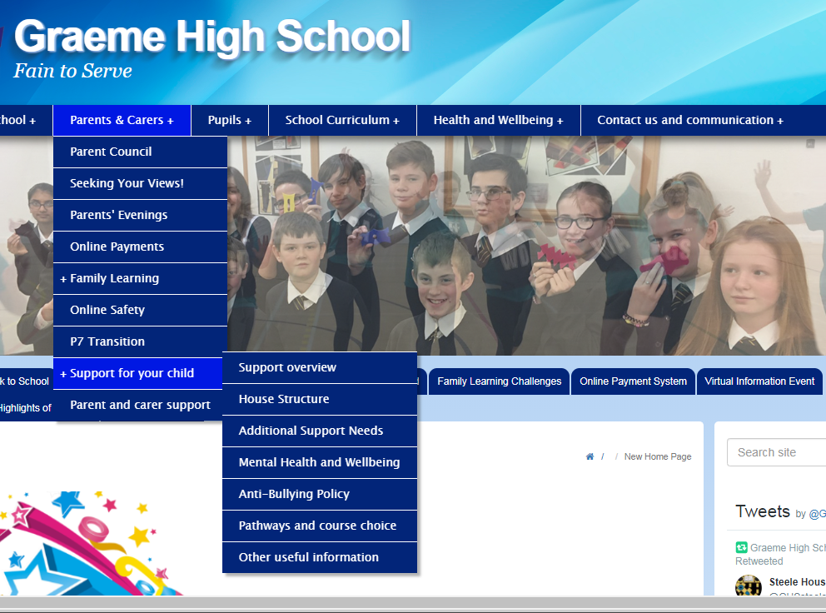

Slide 5
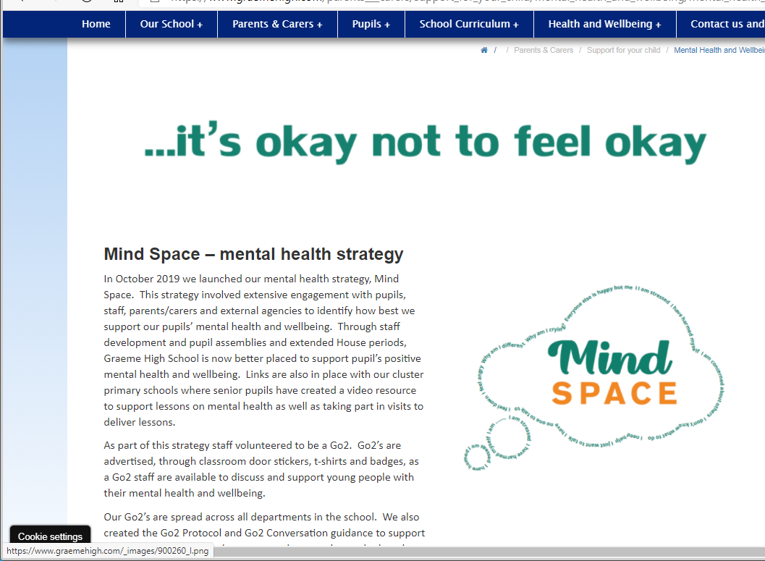
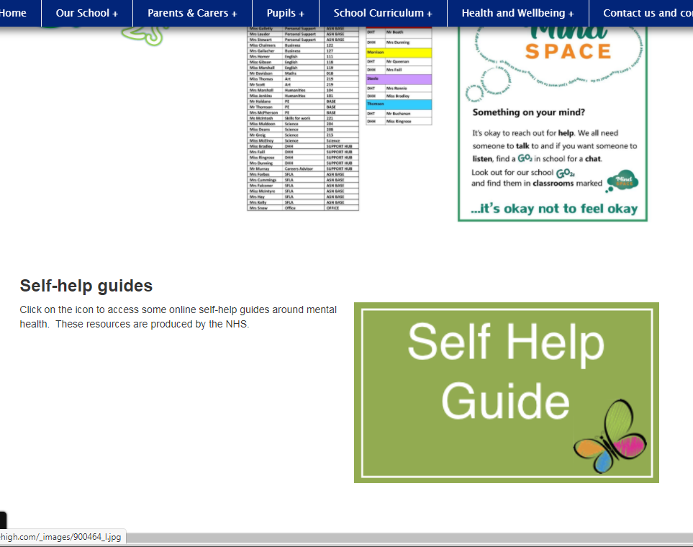

Slide 6
COVID arrangements – what you want to know:
Bubbles and lunch sittings
Cleaning & hygiene protocols
Ventilation, fresh air & warmth
COVID safety on buses
Practical Subject Arrangements

Slide 7
Communications – you asked about:
House Structure
Reporting & Tracking
Parents’ Evenings
Extra Curricular Clubs
Reporting Absence

Slide 8
House Structure
Your son or daughter has been placed into one of 4 Houses in Graeme High. The House structure is really important to us and your child.
The four Houses are –
Lockhart House
Morrison House
Steele House
Thomson House
The House system is used in order to provide a support network for your child. Your child is supported by their House team throughout their time at Graeme High School.
The House teams also compete to win various House Trophies and competitions as well as supporting our House charities.

Slide 9
House Support Structure
Pupil
Senior pupils
Depute Head of House / Named Person
Head of House (DHT)
Faculty PT
Subject teachers
Additional Support Needs

Slide 10
House support structure – Core Support team
House support structure – Core Support team
Depute Head of House (Named Person) Lockhart - Mrs Dunning
Morrison – Mrs Forbes
Steele – Miss Bradley
Thomson – Miss Ringrose
has an overview of your child
will be your main point of contact at the school regarding:
  attendance
  academic performance
  personal issues
  social and emotional issues.
Their role involves providing a liaison between the home and the school to ensure that your child is provided with everything they need to reach their potential.

Slide 11
Communications – you asked about:
House Structure
Reporting & Tracking
Parents’ Evenings
Extra Curricular Clubs
Reporting Absence

Slide 12
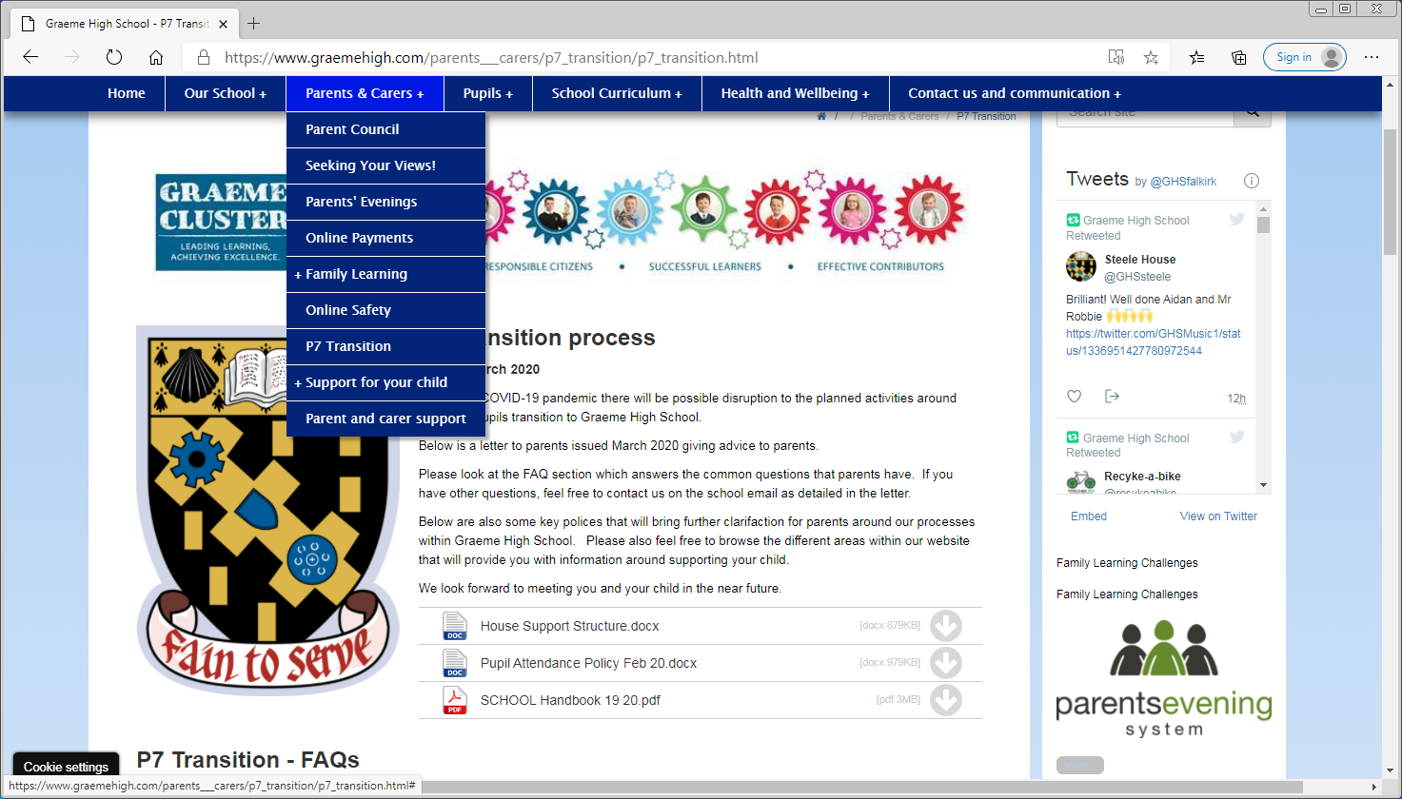

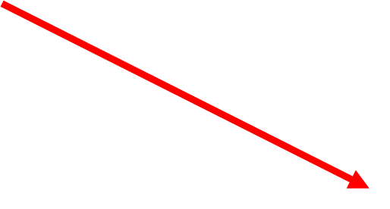
You can access our E-Handbook through our school website.
This provides you with additional information

