Slide 1
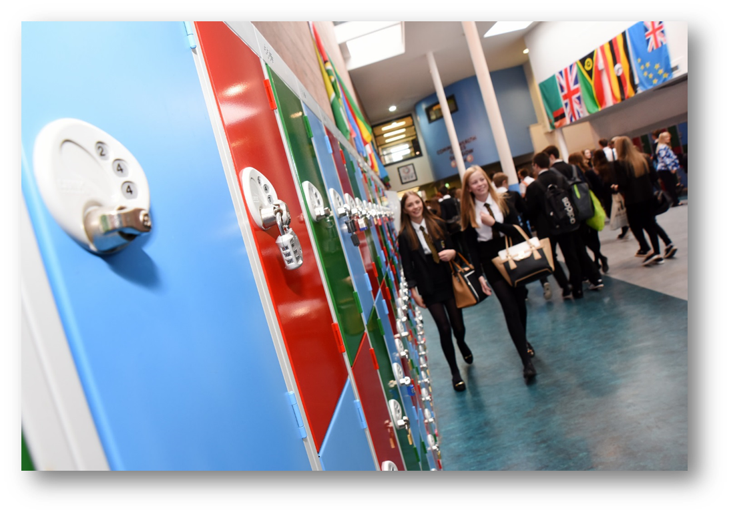

Curriculum for Excellence
My future Pupil Pathways
Course Choice
Graeme High School
Session 2020-2021

Slide 2



Slide 3
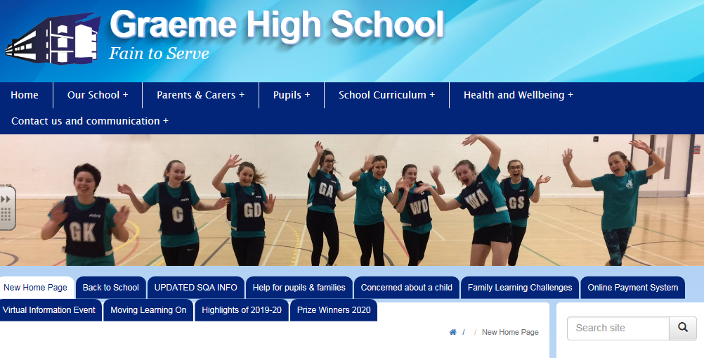

Slide 4
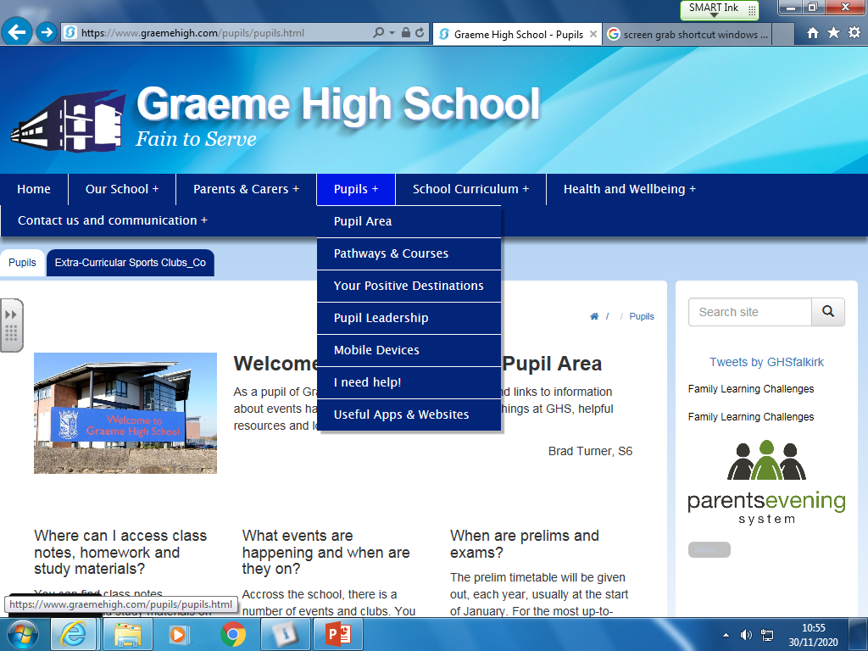

Slide 5
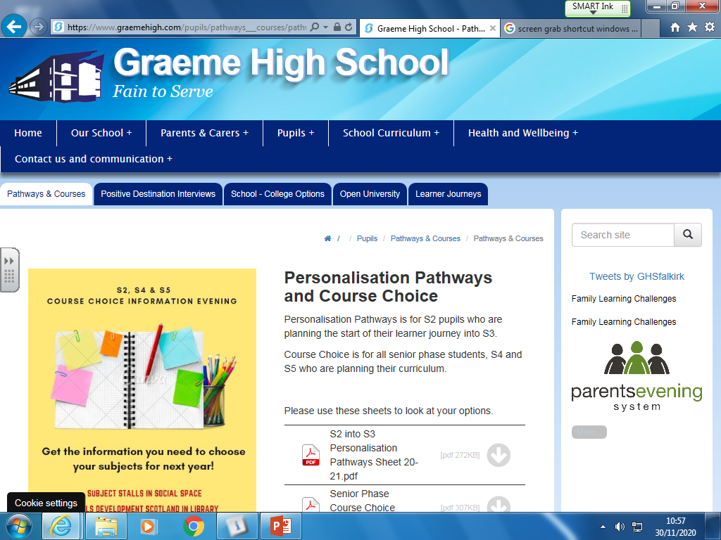

Slide 6
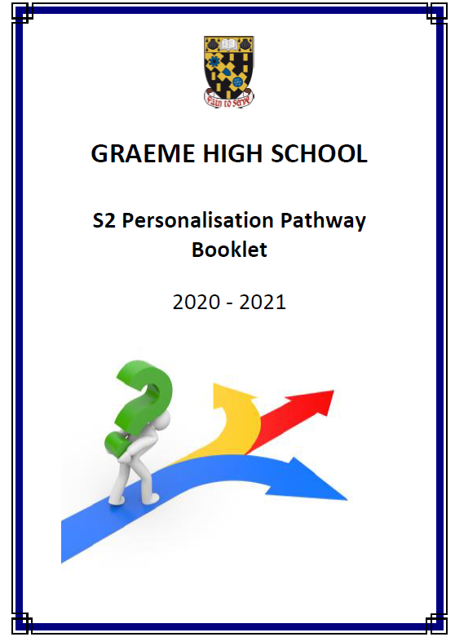
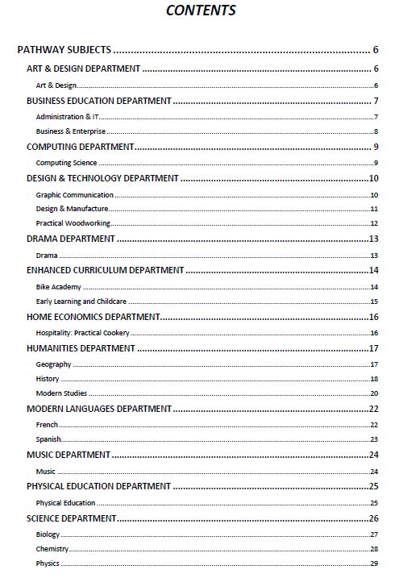

Slide 7
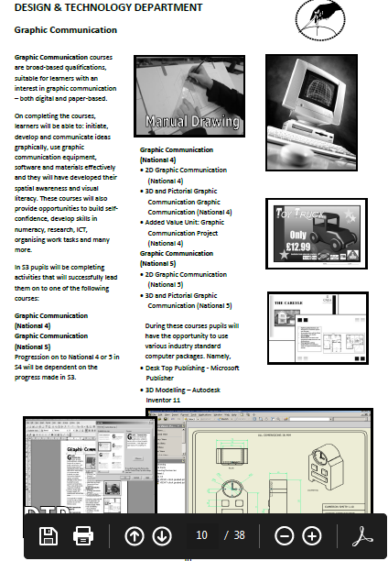
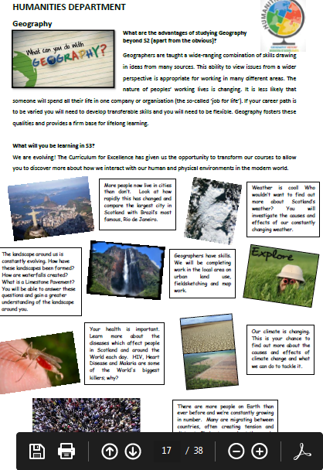

Slide 8
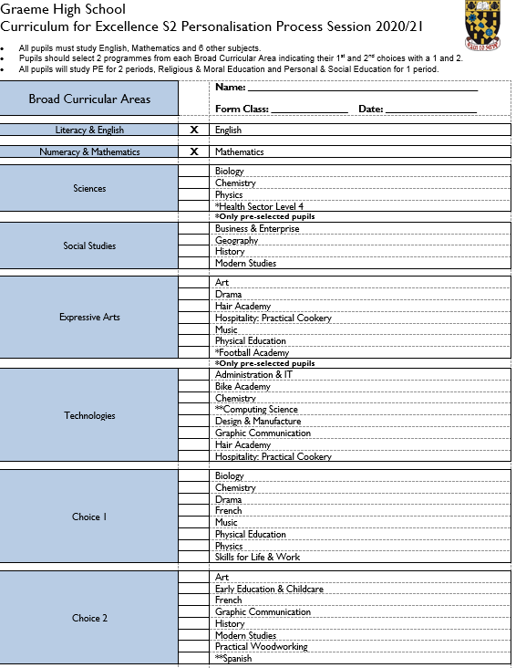
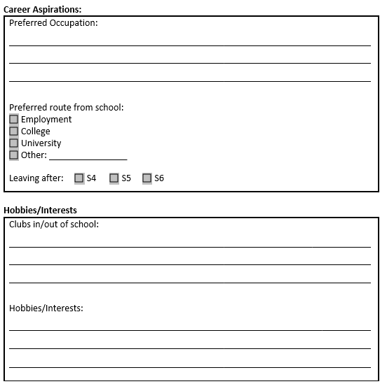

Slide 9
49 Survey returns
Feedback
11 families positive @ materials/approaches
5 families negative @ materials/approaches
Next steps
Common formats, National Materials
Examples pupil journeys, better web links
29 with no experience of options

Slide 10

New site
Or
Better links on existing site?

Slide 11
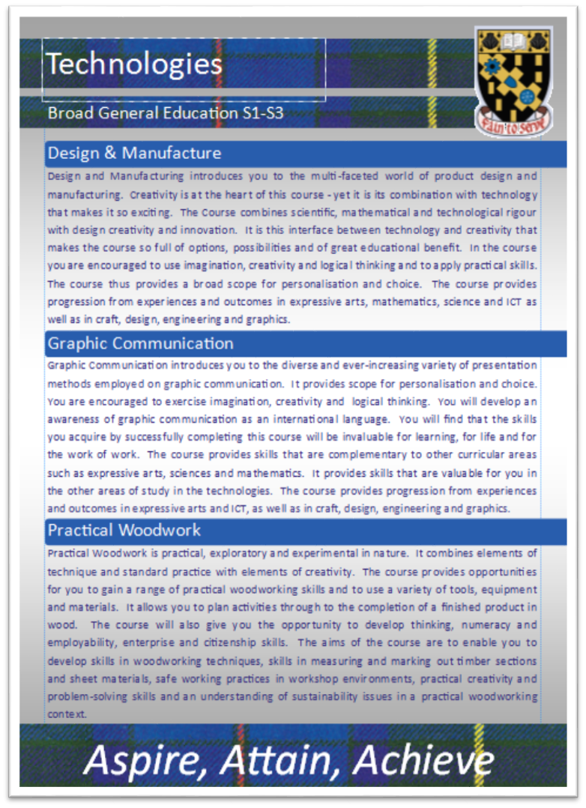
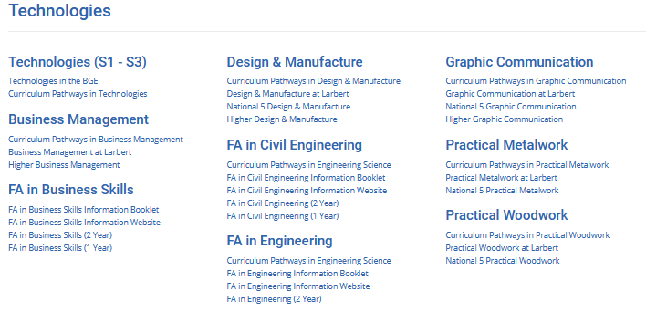

Slide 12
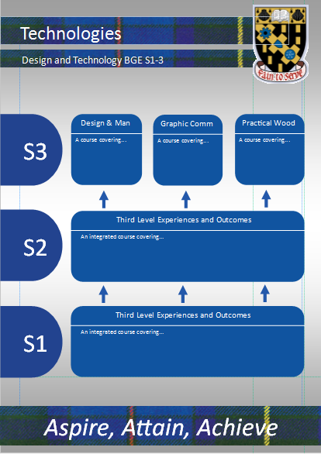
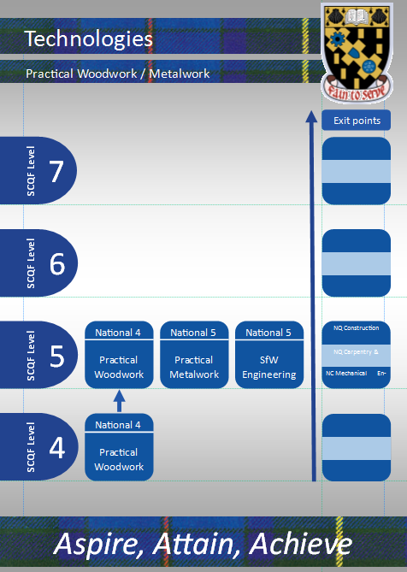

Slide 13



Slide 14
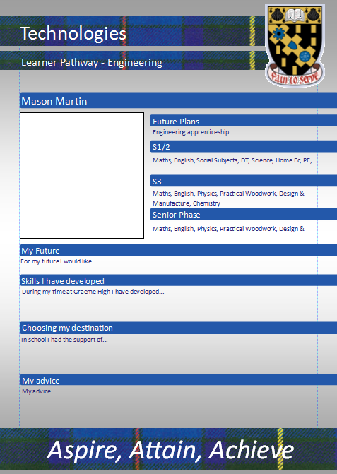
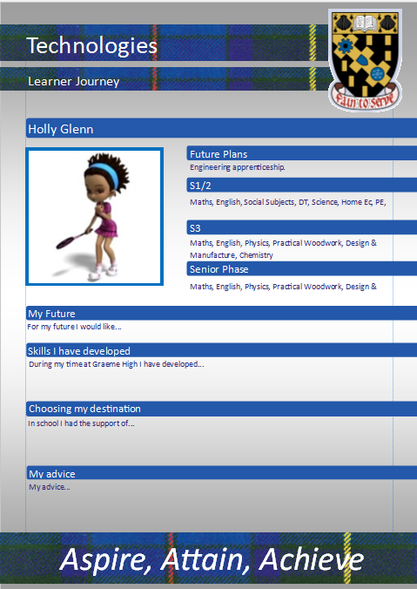

Slide 15




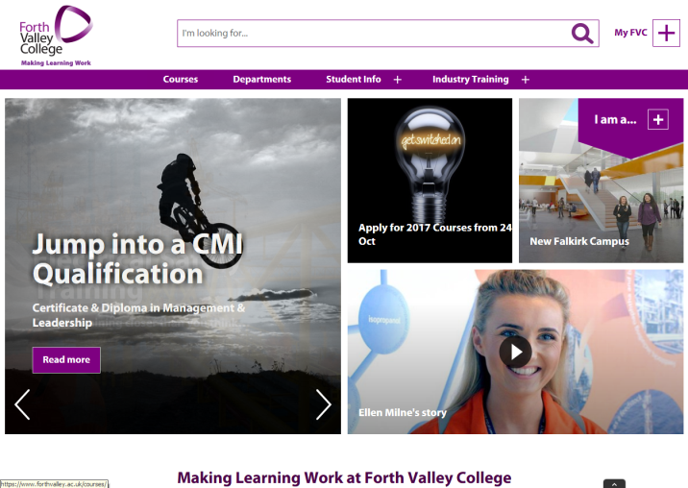
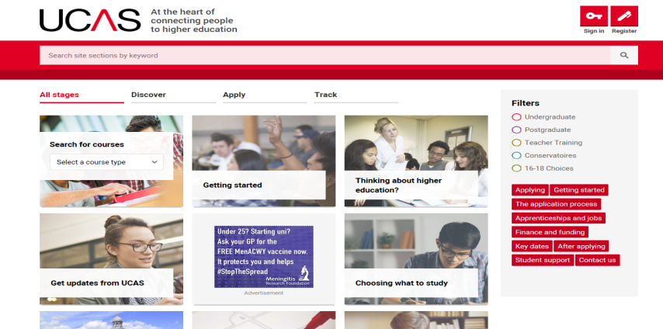



My World of Work
Oatridge College
Which resources do we use in school to support classroom sessions?
Skills Development Scotland SDS (Careers)
School based team & Next Steps Service
Forth Valley College
UCAS
Apprenticeships Scotland
Planit Plus
Cumbernauld College

Slide 16
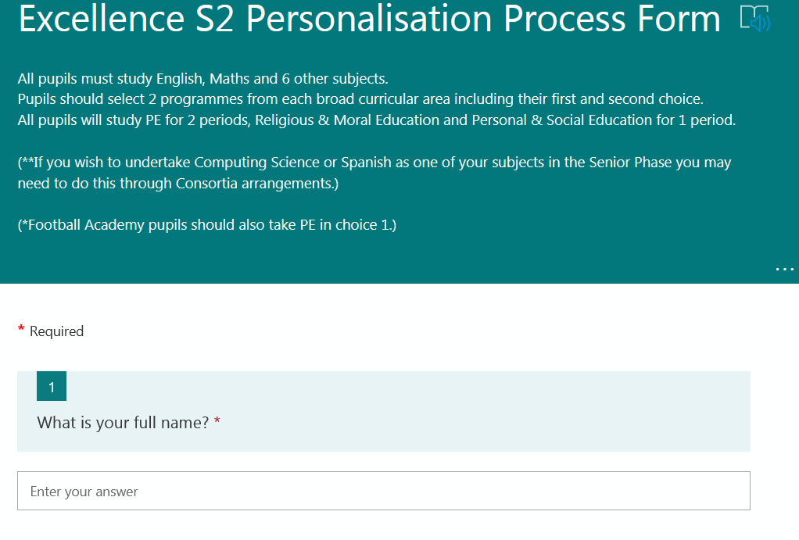
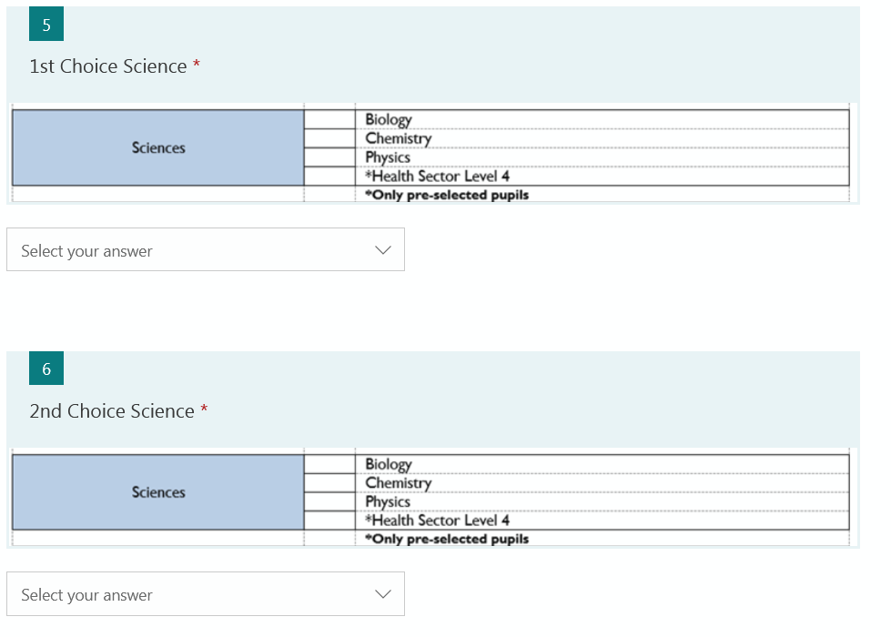

Slide 17


