Slide 1



Your
Application
2020-2021

Slide 2
Applying to university
Applying to university can be a daunting task, but by doing your research, giving yourself plenty of time and seeking the help of others you will be able to create a great UCAS application!
Save a copy of this PowerPoint for yourself – type in it, print it out or complete the tasks on separate paper, whatever is easiest for you and will allow you to access your ideas when you need a reminder.
Remember that your DHH is here to support you every step of the way, just get in touch.
Contents
Slides 1 - 4 | Introduction
Slides 5 - 12 | Contextualised admissions
Slides 13 - 19 | Choosing and applying – send your research to your DHH by 30th June.
Slides 20 -25 | UCAS account and Hub set up
Slides 26 - 28 | Personal details section
Slides 29 -31 | Choices section
Slides 32 - 36 | Education section
Slides 37 - 52 | Personal statement – 1st draft due 16th September.
Slide 53 | Your reference
Slide 54 | Sending the application
Slides 55 - 60 | Post application – what happens next?
Slides 61 - 64 | Finance - SAAS
Slide 65 | Back up plan
Slide 66 | You made it!

Slide 3
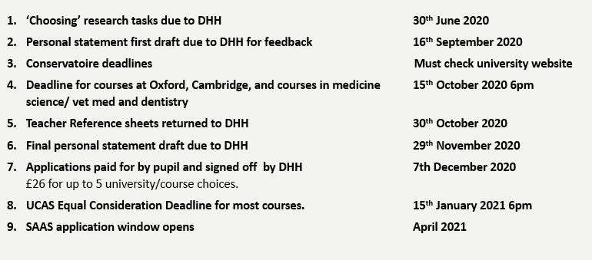
Important dates

Slide 4
Before you get going
Before you get going, here are some key points to keep in mind:
UCAS allows you to submit up to 5 university applications for a fee of £26.
For the majority of courses your deadline is 15 January 2021 at 18:00.
If you are applying to any course at the universities of Oxford and Cambridge, or for most courses in medicine, veterinary medicine/science, and dentistry, your deadline is 15 October 2020 at 18:00 (UK time).
If you are applying to a Conservatoire to study a music course your deadline is likely to be 1 October 2020, 18:00 and 15 January 2021, 18:00 for most undergraduate dance, drama or musical theatre courses. However there are some exceptions, particularly for certain audition locations, international applicants or postgraduate courses, so check the conservatoire websites for full details.
Some courses require you to complete an admissions test, have a look at https://www.ucas.com/undergraduate/applying-university/admissions-tests for guidance as these might need to be completed before your application deadline.
You can edit your UCAS application until it is submitted to UCAS, once it is marked as ‘sent’ it can no longer be edited.
Many universities will be hosting virtual events like open days – look at university websites and sign up for these – you can mention these in your personal statements.
If your application deadline is earlier than 15 January 2021 please let your DHH know now.

Slide 5
Worried about your grades?
Before we start looking at the UCAS application process we wanted to share information about contextualised admissions and widening access.
This could be useful if you are not confident that you will have the grades needed to get into university.

Slide 6
Contextualised admissions and widening access
Contextualised admissions and widening access refers to the information which can be used by universities and colleges to assess an applicant’s achievement and potential within their own individual circumstances.
You might hear or read this being referred to as contextualised admissions, contextualised entry, widening participating or widening access – it all means the same thing really.
Universities use data such as where your school is, how many pupils usually go to university from your school, where you live, if you have been in care, if you are a young carer or if there has been exceptional circumstances that might mean your grades don’t meet the standard entry requirements.
Basically this means that you could be offered a different set of entry requirements than what it says on the university course entry requirements page – for example, where a course says it wants you to have AABBB, contextualised entry requirements could look like ABBBB.

Slide 7
What does that mean for you?
It means that getting to university might be a bit more achievable or less stressful than you first thought!
Let’s look at some examples…

Slide 8
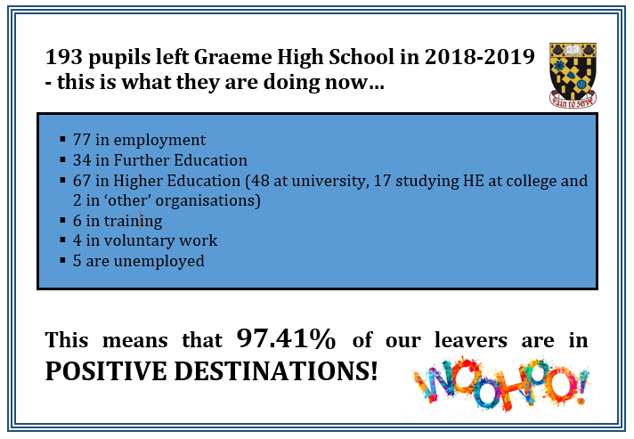
examples
As an example, the University of Strathclyde may offer you a different set of entry requirements because Graeme High School has a low progression rate of pupils moving into university.
As you can see, the majority of our school leavers move into employment – some universities want to encourage more pupils from schools like ours to apply to university.
Strathclyde also offers contextualised admission entry requirements to applicants who are care experienced and those from certain post codes.

Slide 9
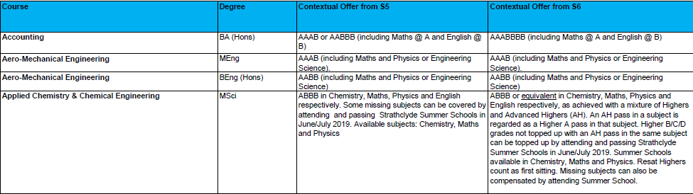
Example offers
From the University of Strathclyde here are just a few examples of contextualised entry offers, these offers are different to what is shown on the main entry requirements information.
See here for their full list of CE offers from 2019/2020 as examples:
https://www.strath.ac.uk/media/1newwebsite/documents/Copy_of_FINAL_-_2019_Entry_Contextual_Offers_for_web.pdf
And here https://www.strath.ac.uk/studywithus/wideningaccess/ for general information about their widening access eligibility.

Slide 10
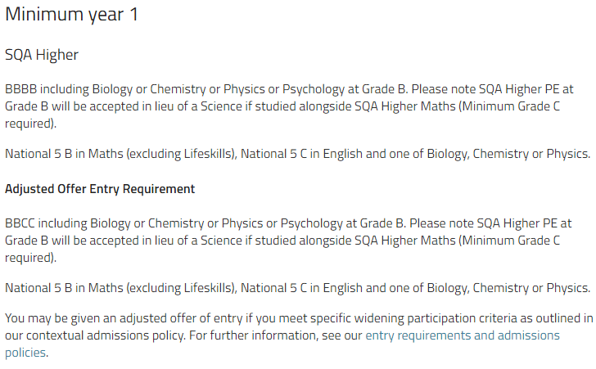
Example offers
See here https://www.strath.ac.uk/media/1newwebsite/documents/Copy_of_FINAL_-_2019_Entry_Contextual_Offers_for_web.pdf for their full list of CE offers from 2019/2020 as examples.
And here https://www.strath.ac.uk/studywithus/wideningaccess/ for general information about their widening access eligibility.

Slide 11
Where else offers this?
It’s important to keep in mind that this information changes every year.
Look at the widening access measures for the universities you are interested in – you should find this by searching within the university’s own search engine.
Last year, however, this is what some universities were using in relation to contextualised admissions.
When it refers to programmes it means planned activities facilitated by or in conjunction with universities. For example, LEAPS.
University | Contextual offer
Edinburgh Napier University | Yes – Postcode, Refugee or Care Leaver.
Strathclyde University | Yes no need for Postcode accepts School.
University West of Scotland | No
Abertay University | Yes - Postcode, Refugee or Care Leaver.
Robert Gordon University | Yes* - Care Leavers and Programmes
Aberdeen University | Yes - Postcode, Refugee or Care Leaver
University of Dundee | No
Glasgow Caledonian University | No
Heriot Watt University | Yes* Care Leavers and Programmes
Stirling University | Yes* Postcode, care experienced, young carer and programmes

Slide 12

In some university widening access pages you might come across a programme called Leaps - LEAPS is a widening participation programme which aims to increase progression to higher education.
LEAPS doesn’t usually support pupils from schools in Forth Valley however, next year, they are hoping to work with us and 13 other Forth Valley schools.
They hope to provide support with the application process and offer impartial advice.
More information about this will come once further discussions have been had with LEAPS.
It’s a lot to think about before you even get started!

Slide 13
Now let’s get started!

Slide 14
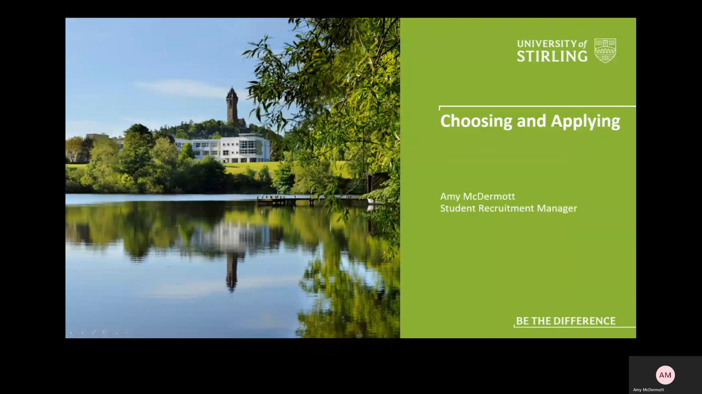
Where to start?
Before you start your application, it’s important to think about what you want to get out of going to university by thinking about what is important to you.
Watch the video below from the start to 10.54 to hear Amy at the University of Stirling speaking about choosing universities and courses.
The video is also saved in S6 20-21 Team – UCAS channel – Files – Choosing and Applying folder - Choosing and Applying

Slide 15
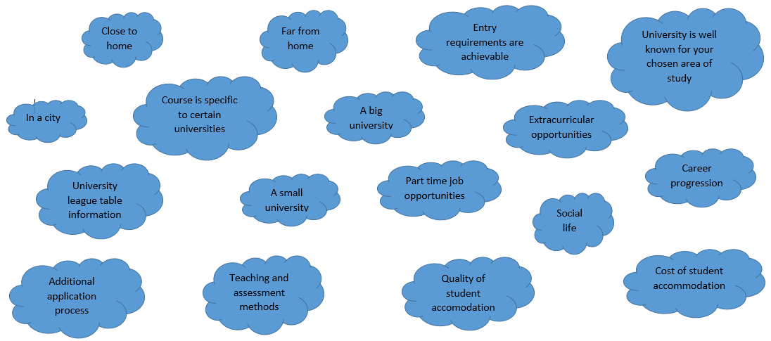
choosing
Thinking about some of the questions put forward by Amy in the ‘Choosing’ section of the video, what do you feel is important to you when considering choosing a university and a course? Note down which of these factors are important to you along with anything else that comes to mind – do this on paper or on the next slide.

Slide 16
Choosing: What is important to me?
Write down what matters to you when thinking about your university applications.
Complete this activity by the 30th June and send to your DHH on GLOW.

Slide 17
Getting started - choosing
Now that you (hopefully) have a clearer idea about what is important to you when choosing universities and courses to apply for, it’s time to do some research so you can be confident that the courses you apply for and the universities they are taught at are right for you.
Activity
Using information from university websites, create a short list – this information will be when it comes to writing your personal statement.
In the next 2 slides I have put in 2 tables that will allow you to pull together your research from this – many of you may not be at the stage of being able to narrow down your choices to 5 yet so you have space for 10.
Feel free to complete this task in a different format if that is easier for you, for example, on paper or in a word document.
Complete this activity by the 30th June and send to your DHH on GLOW.

Slide 18
Short listing
University and course | What appeals to you about this university | Course content that interests you | Career progression | Entry requirements

Slide 19
Short listing
University and course | What appeals to you about this university | Course content that interests you | Career progression | Entry requirements

Slide 20
UCAS ACCOUNT
Now that you have taken a bit of time to carry out some research and to think about what you are looking for, you can now get on with setting up your UCAS account.
Watch this video from 10.54 to 18.17 to hear Amy at the University of Stirling giving you an introduction to UCAS.

Slide 21
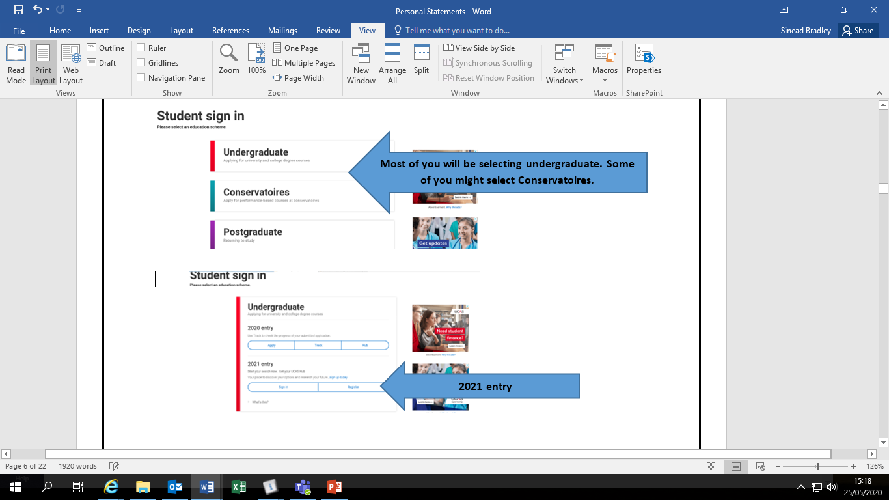
Signing up
When you have watched the video, go to https://www.ucas.com/students and sign up.

Slide 22
Set up
You will be asked to enter your basic information which will register you. Once you have registered and logged in you will be asked how you are applying – select ‘Through my school/college.
You will then be asked to enter the school’s ‘buzzword’ – ours is Graeme2021. This ensures you are linked to our school and allows us to support you with your application.
When asked please ensure you select your House as your ‘Tutor/Application Group as this enables your Depute Head of House to access your application and complete your reference.
Lockhart-Mrs Dunning | Morrison-Mrs Faill | Steele-Miss Bradley | Thomson-Miss Ringrose

Slide 23
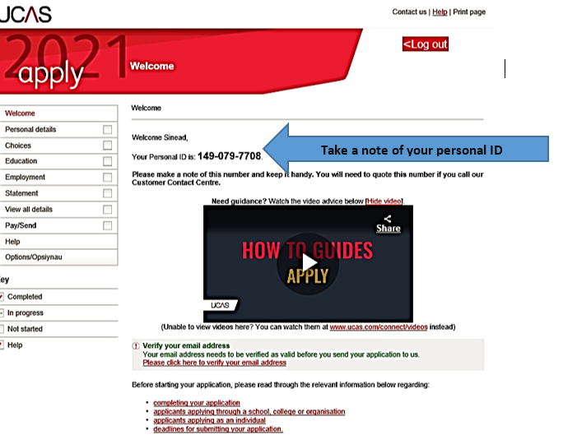
Once you have registered your account you will be able to see your UCAS ‘welcome’ page which looks like this:

Slide 24
Ucas hub
With your very own UCAS Hub, you can plan your next step. The best bit – you can save your progress and carry on whenever you want.
We’ve created lots of handy tools to help you make choices and start your application:
The explore tool – where you can search subjects and discover courses.
The notepad – so you can keep all your thoughts about your next step in one place.
Apprenticeship finder – for the latest vacancies, locally and nationally.
The personal statement builder – to help you structure your writing and introduce yourself to universities.
The Tariff calculator – for tallying up your UCAS points to see if you meet entry requirements.

Slide 25
UCAS HUB sign up
The UCAS Hub is free and easy to use. All you need to do is follow these three simple steps to sign up:
Step 1 – Register
To get started, visit ucas.com/hub.
Step 2 – Verify your account
Once you’ve registered, you’ll be asked to verify your account. An email will be sent to the email address you registered with and all you need to do is hit ‘Activate account’.
Step 3 – Sign in
Now you’re ready to sign in and start exploring! The first time you do, we’ll ask you some extra questions so we can help you find the right info.
To pick up where you left off, visit ucas.com/hub or click ‘Sign in’ on the top right hand side of any page on ucas.com and select ‘Students’.

Slide 26
Now you can start your application

Slide 27

Personal details
There will be sections in this that are easy for you to complete now and there are others that will need to wait until after the summer holidays, for example your SQA results and your final choices.
The Personal Details section is one that you can complete quite quickly.

Slide 28
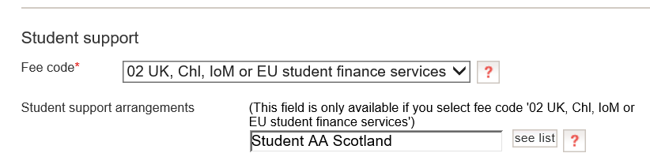
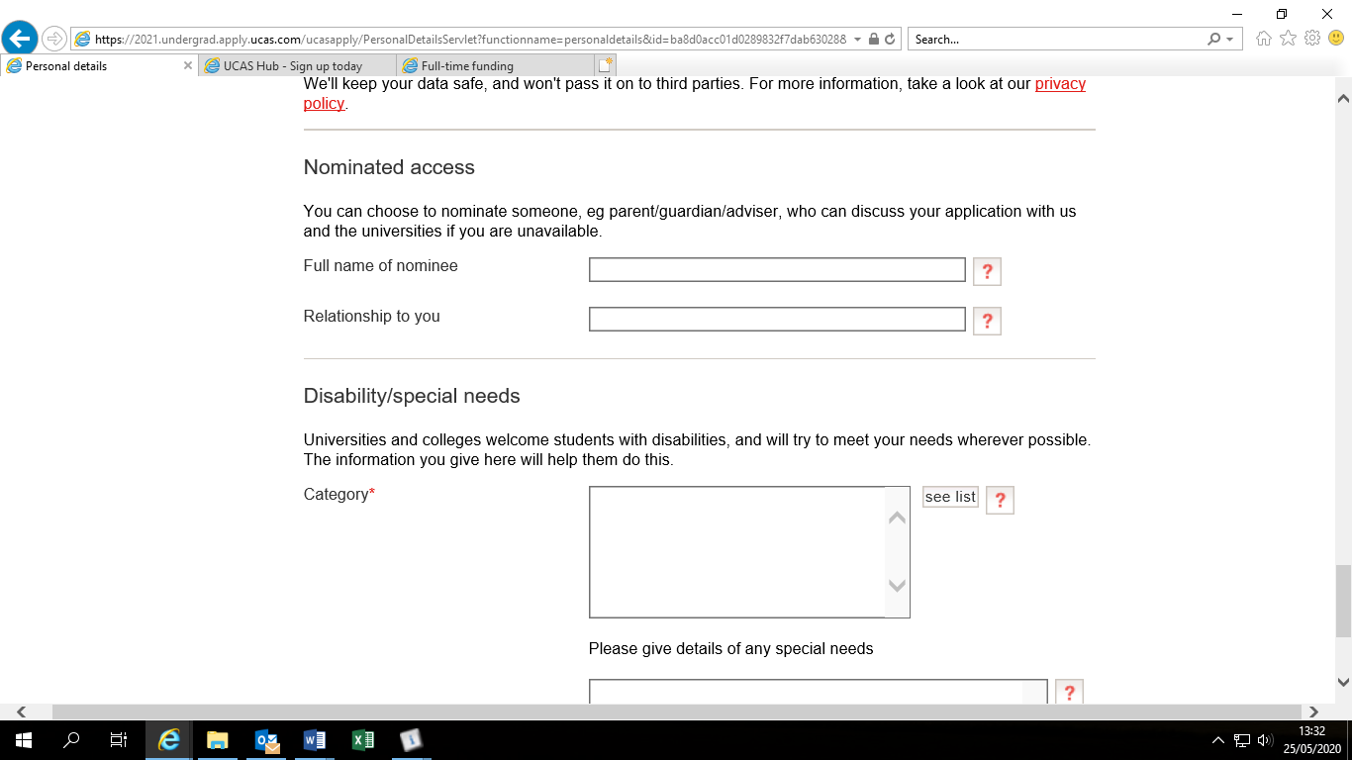
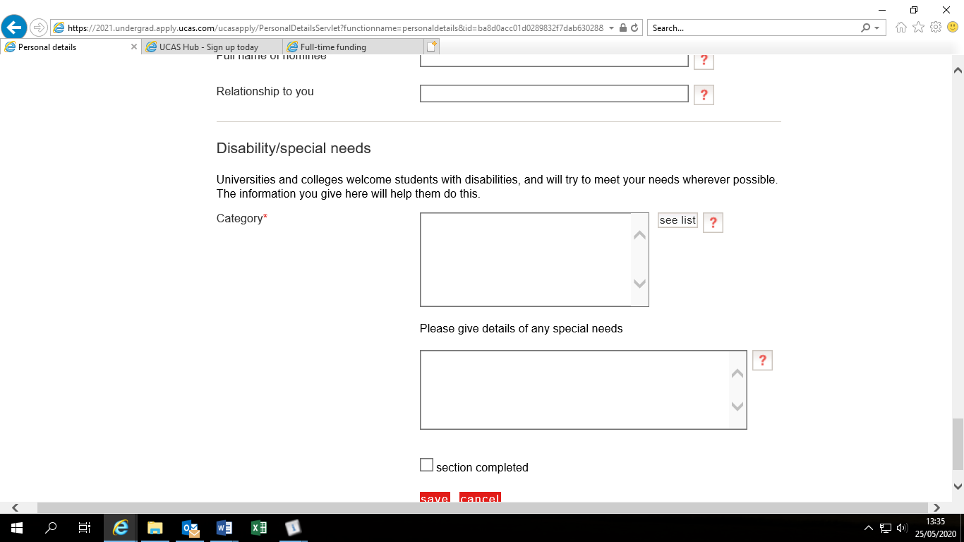
In the Personal Details section you will be asked to provide some basic information about yourself and will also be asked about Student Support, Nominated Access and Disability/Special Needs.
For most applicants, this is what you should choose. Information about funding eligibility can be found at: https://www.saas.gov.uk/full-time
UCAS and your chosen universities will not discuss your application with anyone other than you unless you provide the name of a person you are happy for them to speak with on your behalf.
Telling a course provider about this early means they will try to make the arrangements or adjustments to help you succeed.
The information you provide here will not negatively impact your application.

Slide 29

Adding your choices
When you have decided on your choices you can complete this part of your application.
It is quite straightforward to add the information but you might take quite a bit of time before you are ready to make a final decision.
To introduce this section you can watch this short video: Filling in your choices

Slide 30
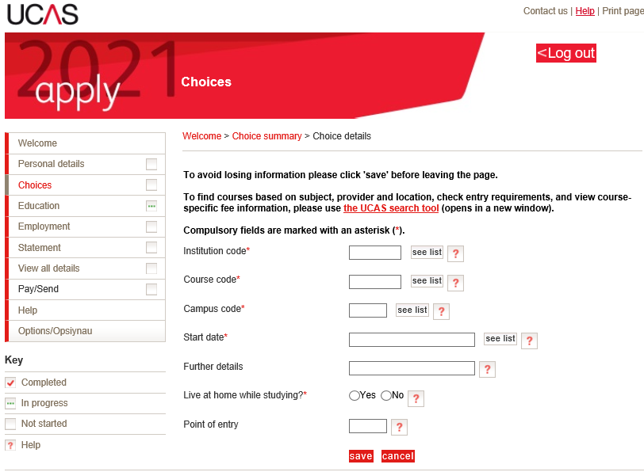
choices
You can choose up to 5 courses to apply to.
After you select ‘add a choice’ you will be taken to a page which looks like this.
UCAS asks if you plan on living at home while studying so the university can be informed of your plans – this allows universities to share relevant information with you.
Remember to make sure your course code on UCAS matches the university course code on their course information page, look at the next slide for an example of this.

Slide 31
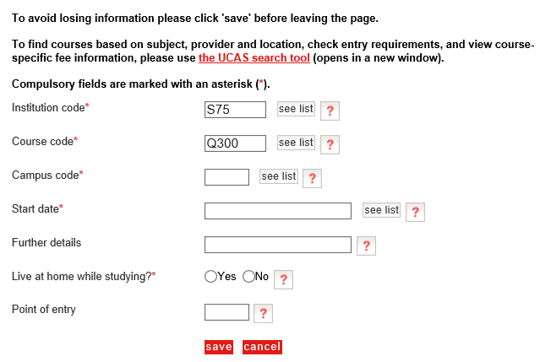
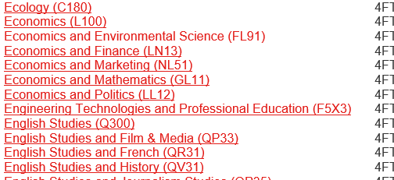

In the course code box, select see list and type in the name of the course. Select the course – this then populates the box with the code.
You should find the UCAS code on the course information page on the university website.

Slide 32

education
In this section you will tell universities what qualifications you have and what qualifications you are working towards.
Click this video link which outlines how to complete this part of the application - Completing the education section

Slide 33
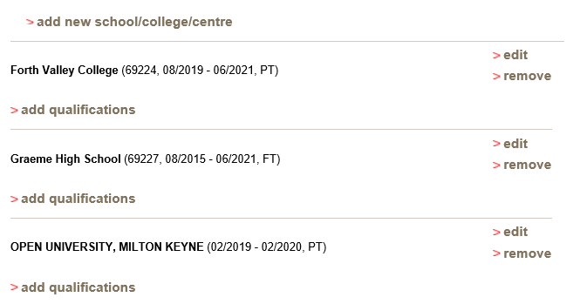
Education
Don’t forget to add in qualifications you have gained or are working towards from other centres.
Once you have added your school/college/centre you can add qualifications under the relevant establishment.

Slide 34
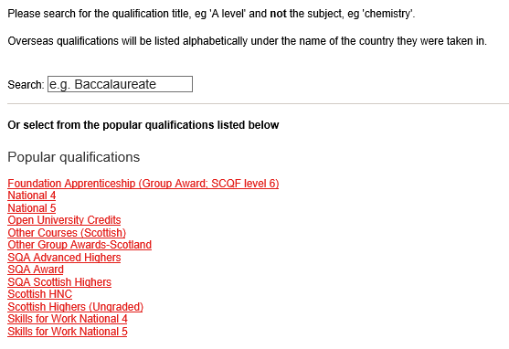
Adding qualifications
When you click ‘add qualification’ you can search for your qualification or look through the Popular Qualifications which have been short listed for you.
When you select the relevant qualification it will take you to a drop down list of courses or, depending on the type of qualification, will give you space to manually type in the name of the course.
You do not need to add in individual modules or units unless that is all you have.
Keep your SQA certificate handy when completing this as this will show all SQA qualifications you have.
For subjects you do not have grades for yet (qualifications from this year) choose Pending.
You can either put May or August

Slide 35
Course codes
Code | Level | Course Name
C806 | ADVH | Art & Design (Design)
C805 | ADVH | Art & Design (Expressive)
C807 | ADVH | Biology
C813 | ADVH | Chemistry
C824 | ADVH | English
C830 | ADVH | French
C847 | ADVH | Mathematics
C850 | ADVH | Music
C857 | ADVH | Physics
C801 | HIGH | Administration & IT
C804 | HIGH | Art & Design
C807 | HIGH | Biology
C810 | HIGH | Business Management
C813 | HIGH | Chemistry
C816 | HIGH | Computing Science
C819 | HIGH | Design & Manufacture
C821 | HIGH | Drama
C824 | HIGH | English
C830 | HIGH | French
C833 | HIGH | Geography
C835 | HIGH | Graphic Communication
C837 | HIGH | History
C847 | HIGH | Mathematics
C849 | HIGH | Modern Studies
C850 | HIGH | Music
C854 | HIGH | Philosophy
C855 | HIGH | Photography
C856 | HIGH | Physical Education
C857 | HIGH | Physics
C864 | HIGH | RMPS
Here is a list of course codes for the Highers and Advanced Highers sat by pupils at GHS in the last year.

Slide 36
In the education section remember to include qualifications such as:
Higher Leadership
Sports Leaders
HNC
Foundation Apprenticeship
Skills For Work
NPA
Open University modules
Some of these are a bit trickier to enter:
After selecting Add Qualification under the appropriate organisation:
1. Add Higher Leadership by selecting ‘other group awards-Scotland’ from the popular qualifications list– type Higher Leadership course code is G9D4 46.
2. Add Sports Leaders by finding ‘Other (UK) qualifications’ – you will need to type this into the search box after you select to add qualifications. The Awarding Body is SLQ.
3. Add Open University modules by selecting ‘Open University credits’ from the popular qualifications list at the bottom of the page. Manually add in the name of the module and how many credits it is worth.
4. Add NPA Sport and Fitness and Leadership as two separate qualifications – NPA Sport and Fitness by selecting ‘other group awards-Scotland’ and typing the name of the course and course code (GC9G 45) into the box. Enter Leadership separately as outlined in bullet point 1.
5. Add Engineering, Early Education and Childcare, Health Sector and Travel and Tourism by selecting Skills for Life and Work National 4 or National 5 from the popular qualifications list. From there you will see a drop down of the Skills for Life and Work courses at that level.

Slide 37
Your personal statement
Summarising yourself in 4000 characters

Slide 38
What is a personal statement?
A personal statement supports your application to study at a university or college.
It is a chance for you to articulate why you’d like to study a particular course or subject, and what skills and experience you possess that show your passion for your chosen field.
Your personal statement is your chance to tell the university who you are - they know what grades you have but they no nothing else about you, so TELL THEM!
In the next slide, listen to Amy from the University of Stirling talk about writing your personal statement.
In this webinar she goes over some facts about the personal statement, things for you to consider, what universities are looking for and some extracts from personal statement.
Listen and take notes!

Slide 39


Slide 40
mack
Maturity – personal readiness for university study. Think about: Able to take personal responsibility for learning Adapt to teaching and learning provision Self-confidence and self-discipline Cope with pressure Positive influence on others
Ability – academic attainments and general skills. Think about: Knowledge and understanding of pre-requisite materials Necessary study and assessment skills Apply analytical and transferrable skills
Commitment – history of sticking to the task. Think about: Personal commitment to study for degree Able to stick to task and not give up Prepared to work hard
Knowledge – understanding of what lies ahead. Think about: What the degree involves What the institution provides Demonstrate interest in subject Realistic view of where degree lead
In the webinar you heard Amy mention ‘MACK’ – do you have examples of these?
Tick off those which you feel you demonstrate.

Slide 41
Getting words on paper
Now that you have thought a bit about whether or not you can demonstrate maturity, ability, commitment and knowledge let’s get some of your ideas on paper.
In the next two slides are tables for you to complete – this is to guide you into thinking more deeply about the experiences, skills and qualities you have and how you can make use of these in your personal statement.
You might want to break down one experience into smaller chunks, for example, work experience will have provided you with many experiences – talk about each experience in it’s own right.
Here are some examples of skills and qualities you could include:
Communication
Organisation
Working under pressure
Working to deadlines
Team work
Leadership
Prioritisation
Reliability
Flexibility/adaptability
Time management
Resilience
Confidence
Problem Solving
Creativity
Empathy
Compassion
Integrity
Interpersonal
Commitment
Motivation
Enthusiasm

Slide 42
Experience: An example of something you have done or achieved which is related to your course | Skills/qualities: What skills/qualities did you gain or demonstrate during this experience? | Relate: How do these experiences and skills relate to your 5 choices? | MACK: Does this example show your maturity, ability, commitment or knowledge?

Slide 43
Experience: An example of something you have done or achieved which is related to your course | Skills/qualities: What skills/qualities did you gain or demonstrate during this experience? | Relate: How do these experiences and skills relate to your 5 choices? | MACK: Does this example show your maturity, ability, commitment or knowledge?

Slide 44
Before you start writing
Important things to remember about your personal statement:
You are telling staff why you are suitable to study at their university or college.
You can only write one personal statement – it is the same for each course you apply for so avoid mentioning any universities or colleges by name.
Your personal statement has a maximum character count of 4000 characters (including spaces) or 47 lines – whichever comes first.
It should be related to the courses you have applied for – this means that the courses you apply for must be similar.
Plagiarism software is used to detect when someone is trying pass of someone else’s personal statement as their own. This can include copying extracts from other statements.
Go to https://www.ucas.com/explore/subjects to look at a general overview for the area of study you are applying for. Take note of some of the language used to describe the subject area and try to keep this in mind as you write your statement.
Be prepared to write several drafts and to take advice on board.

Slide 45
Help guides
https://www.ucas.com/file/4261/download?token=u7I6M9Q5 – This worksheet takes you through some of the key points to include in your personal statement. A copy of this is also saved in the S6 2020 2021 Team – UCAS channel – Files – Writing Your Personal Statement folder.
https://www.ucas.com/what-are-my-options/create-your-ucas-hub-today - In your UCAS Hub you can use the personal statement builder tool – this guides you through writing your personal statement.

Slide 46
Structuring your personal statement
Now that you have some of your ideas pulled together it is time to start writing your statement.
How you structure your statement is up to you but it is important that your train of thought throughout is clear and that you have a clear introduction, main body of work and a conclusion. For example:
Introduction – what you are applying for and why.
Subjects you have studied which have allowed you develop knowledge and understanding of the course you’re applying for – linking to skills and qualities and relating to courses.
School leadership roles and extra curricular activities – linking to skills and qualities you have developed and demonstrated and relating to courses.
Work experience/part time work – your responsibilities and what skills it has allowed you to develop and relating to courses.
Other hobbies/interests that have allowed you to develop your skillset – this should be brief.
Conclusion – pulling your thoughts together and looking to the future.

Slide 47
introduction
It is normal to get caught up in trying to come up with a good opening line – try not to get hung up on that just now, you can come back to it.
You might even leave writing your entire introduction until the end, that is okay too!
What you are applying for and why…
Things to consider:
Does the degree relate to an interest or passion of yours?
Why does this interest you?
Why are you excited about this course?
How do you feel about the possibility of studying this course?
Have you read or seen something that has really sparked an interest in this area of study?
What career prospects does the degree offer?
Does the degree fit well with your skills and qualities?
AVOID CLICHÉS!
Try to avoid the most obvious opening sentences in your personal statement.
Every year UCAS publishes a list of the most common opening lines in personal statements to help applicants avoid using these worn-out phrases. Previous years' top five included:
'From a young age…'
'For as long as I can remember…
'I am applying for this course because…'
'I have always been interested in…'
'Throughout my life I have always enjoyed…'

Slide 48
Main body
What is included is quite specific to you but applicants often use a combination of:
Relevant school subjects
Leadership opportunities such as Prefect, Captain, House Leader, House Charity Leader, Language Ambassador, Sports Leader…
Clubs in and out of school
Sporting and/or creative activities in and out of school.
Work experience
Employment
Guides, Boys Brigade, Cadets, youth group, Duke of Edinburgh…
Hobbies such as computer coding and reading literature related to university courses.
As you discuss these experiences, ensure you are linking them to your skills and qualities whilst also relating them to the courses you are applying for i.e. why they evidence your readiness to study this course at university.

Slide 49
conclusion
Pulling your final thoughts together into your conclusion is tricky and requires a careful balance – it should add something special to your statement but it shouldn’t have lots of new information. Consider:
Tying your conclusion back to the rest of your statement by summarising some of your key points.
Portraying your interest and enthusiasm by outlining what you are looking forward to most about the course and the overall university experience, for example, meeting new people, joining clubs and societies etc…
Demonstrating that you are goal orientated and optimistic about your future by mentioning a career path you are interested in.

Slide 50
Personal statement examples
In the S6 2020 2020 Team – UCAS channel – Files – Writing Your Personal Statement – Example Personal Statements you will find some examples.
These are by no means perfect but they are good examples to give you an idea of how to structure your ideas.
You will also find examples online, however, please use caution when looking at these – the last thing you want is for your statement to sound like the thousands of other statements that reach the admission team inbox.

Slide 51
Final checks
Do show you know your strengths, and outline your ideas clearly.
Do use clear, concise and formal language.
Do be enthusiastic – if you show you’re interested in the course, it may help you get a place.
Do expect to produce several drafts of your personal statement before being totally happy with it.
Do ask people you trust for their feedback
Do look again at the course information and read your personal statement to yourself – can you tell from your reading your statement that these are the courses you are applying for?
Don’t be tempted to buy or copy a personal statement, or share yours. All personal statements are checked for similarity – if your personal statement is flagged as similar to other applicants, it could affect your chances of being offered a place.
Don’t exaggerate – if you do, you may get caught out in an interview when asked to elaborate on an interesting achievement.
Don’t rely on a spellchecker, as it will not pick up everything – proofread as many times as possible.
Don’t leave it to the last minute – your statement will seem rushed, and important information could be left out.
Don’t let spelling and grammatical errors spoil your statement – a good way to do this is to read it out loud to yourself and have someone read it to you. This will help you to pick out issues with punctuation or poor choices in phrasing.

Slide 52
Don’t forget
1st draft deadline is 16th September 2020.
Final draft deadline is 29th November 2020.
Your DHH needs time to read your statement and provide you with feedback so stick to the deadlines.

Slide 53
Ucas reference
Your DHH writes your reference using a combination of their knowledge about you along with information that your teachers will provide.
To gather this information you will be asked to give teachers an information request form – an example of the teacher reference sheet is in the S6 Teams - UCAS channel files.
Your DHH wants these returned to them by the 30th October to ensure they have enough time to use the information to write you a good reference.
You must give a copy of this form to your current teachers as they need to provide predicted grades. You can also give copies of the form to teachers who you feel know you well.
Your DHH will enter these predicted grades into the reference section of your application and will upload a copy of the reference – we will let you see the reference before we submit it.
If there is anything you would like to your DHH to say in the reference i.e. an activity we don’t know you’re involved in, please let use know.

Slide 54

Sending your application
In order for your application to be submitted all sections must be marked as complete.
Once all information has been added to your application, UCAS will allow you to pay – you do this online with a bank card. If there are any issues with this please discuss with your DHH.
You ‘send’ your application but it actually goes to your DHH.
Once your DHH has completed some final checks, have uploaded their reference and entered your predicted grades, they hit the send button which submits your final application to UCAS.
You still have more to do though! Make sure you read all emails from UCAS and ensure that your follow all instructions they give you.

Slide 55
After you have applied
Now that your application has been submitted it is time to wait. This can be a frustrating and nerve wracking time as, not only are you anticipating your offers, you will also hear about other people in your year receiving university offers before you.
Do not worry about this!
Each university and admissions team work to their own admission systems and deadlines, allocating spaces based on their own admissions process.
If you submitted your application by the 15th January, you should have received all offers by the 6th May.
If you are applying to Oxford or Cambridge you will likely attend your interview in November or December and will usually be notified of a decision by the end of January.
Some people might start getting offers in within a week of submitting their application and others might need to wait until May – this is all normal and does not hint at the university’s decision.

Slide 56
Post application
Watch from 18.17 until the end to hear Amy at the University of Stirling talk about what to expect post application.

Slide 57
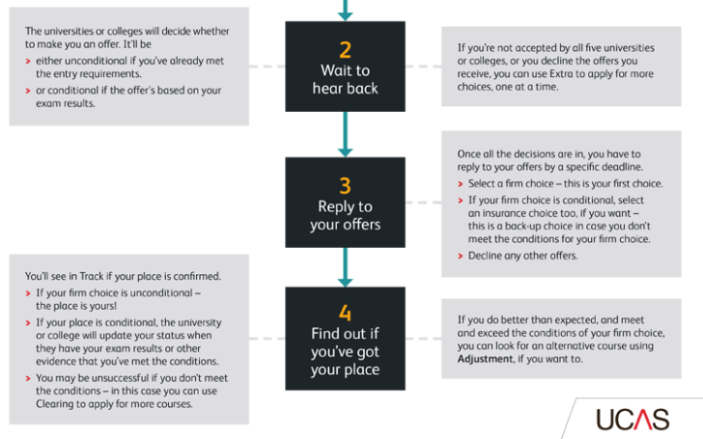
You’ve completed stage 1 – apply but there is more to do!
You will be given deadlines by UCAS to reply to your offers – you must reply by these deadlines or you risk having you application withdrawn by the university.

Slide 58
reply
These are the types of ‘reply’ you can make:
Firm acceptance – this is your first choice.
If it's an unconditional offer, the place is yours! So that course provider will expect you as their student.
Or if it's conditional, the place is yours if you meet the offer conditions. So just in case you don't, you can pick a second offer as a backup – your insurance acceptance.
Insurance acceptance – the back-up choice to a conditional firm acceptance.
If you're choosing an insurance, go for something with lower offer conditions – make sure it's somewhere you'd still be happy to go to though.
That way, if your results are lower than expected, you might still meet the conditions at your insurance choice; then you'd have your place confirmed there.
Remember, you'll only attend your insurance choice course if you don't meet the conditions of your firm choice, but you do meet the conditions of your insurance. You can't choose between your firm and insurance when you get your results, so make sure you're happy with which is your firm and which is your insurance before you reply.
Decline – you'll need to decline any other offers you get.
However, if you decide you don't want to accept any of the offers, you can decline them all and add more courses in our Extra service. Alternatively, you can see what courses still have vacancies later on in our Clearing service.

Slide 59
Offer and reply
Offer and reply combinations:
Unconditional firm (UF) – You're in!
Conditional firm (CF) – You're in if you meet the conditions.
Conditional firm (CF) and conditional insurance (CI) – You've made a first and second choice – you'll be in at the first if you meet the conditions. If not, you might have met the conditions of the second – if so you'll be on that course instead.
Conditional firm (CF) and unconditional insurance (UI) – You've made a first and second choice – if you meet the conditions of the first you'll be on that course. If not, you'll definitely be on the second.
Go to https://www.ucas.com/undergraduate/after-you-apply/types-offer/replying-your-ucas-undergraduate-offers for more information about how to reply to your offers.

Slide 60
Hopefully you now have a place!

Slide 61

If you’re going to study a full time HNC, HND, Degree or PGDE course at college, university or a private provider you may be available for Higher Education funding. The SAAS funding application window for your application cycle (2021-2022) will open in April 2021.
If you live and study in Scotland, SAAS will pay your tuition fees directly to your university – you do not pay back these fees.
If you decide to study somewhere else in the UK, you can apply for a tuition fees loan of £9250 (information up to date as of 26.05.20 but may change in the next academic year) which you will pay back.
You have to apply for funding every year of your course – applying for your funding before June of the year you start your course will ensure your funding is in place when you start. For example, if you start your course in September 2021, apply between April and June 2021.

Slide 62
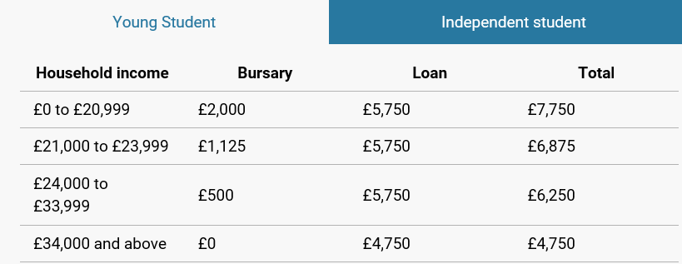
Bursary and loan
You can also apply for a bursary and/or loan from SAAS – this is dependant on your household income. Most applicants from schools are classed in the young student category because they are under 25.
However there is different funding options available for young people who are estranged from their families or for individuals who are care experienced – look at https://www.saas.gov.uk/ to make sure you find the information that is relevant to you.
Based on these household incomes, this is what applicants could be eligible for.
If you are applying to Nursing or Midwifery you are entitled to a different bursary

Slide 63
Nursing and midwifery bursary
If you are applying for nursing and midwifery courses you are entitled to a different bursary option which entitles you to a non income assessed bursary of £10,000 for years 1, 2 and 3 of your degree and £7500 in the 4th year.
This non income assessed bursary is designed to support the cost of living during your degree and you do not pay it back.
You are not eligible to apply for a loan from SAAS in addition to this bursary.
Look at https://www.saas.gov.uk/full-time/funding-information-for-nursing-and-midwifery for more information.

Slide 64
Discretionary funds
If you experience financial difficulty while you are at university you are entitled to apply to your university’s discretionary fund – do this by contacting your Student Services.
This funding is not designed to be a main source of income and is generally used to support students through unforeseen circumstances or hardship.
As an example look at https://www.stir.ac.uk/student-life/support-wellbeing/student-support-services/money-support/discretionary-and-assistance-funds/ which outlines the University of Stirling’s funding support.
If you do experience financial hardship at university please speak to someone at Student Services – they are there to provide support and guidance.

Slide 65
Have a back up plan…
Now that your application to university is in and you know what you need to do when it’s time to apply for funding, it’s now time to get yourself sorted with a couple of back up plans.
We always advise our university applicants to submit college applications too – you already have a good personal statement which you can now adapt to suit any of the courses you want to apply for.
Forth Valley College usually open up their applications for the following academic year in October or November whereas other colleges usually open their applications from January or February.
Let your DHH know what your back up plan is so we can offer support and guidance.

Slide 66

Phew, you made it!
Fast forward to September 2021 and you will be getting ready to start a new and exciting chapter of your life!
Well done for all of your hard work and commitment in getting to this stage, we are all incredibly proud of you all.

