Slide 1
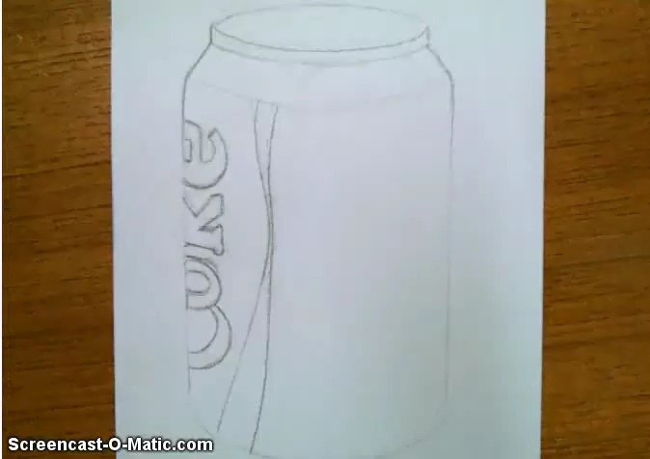
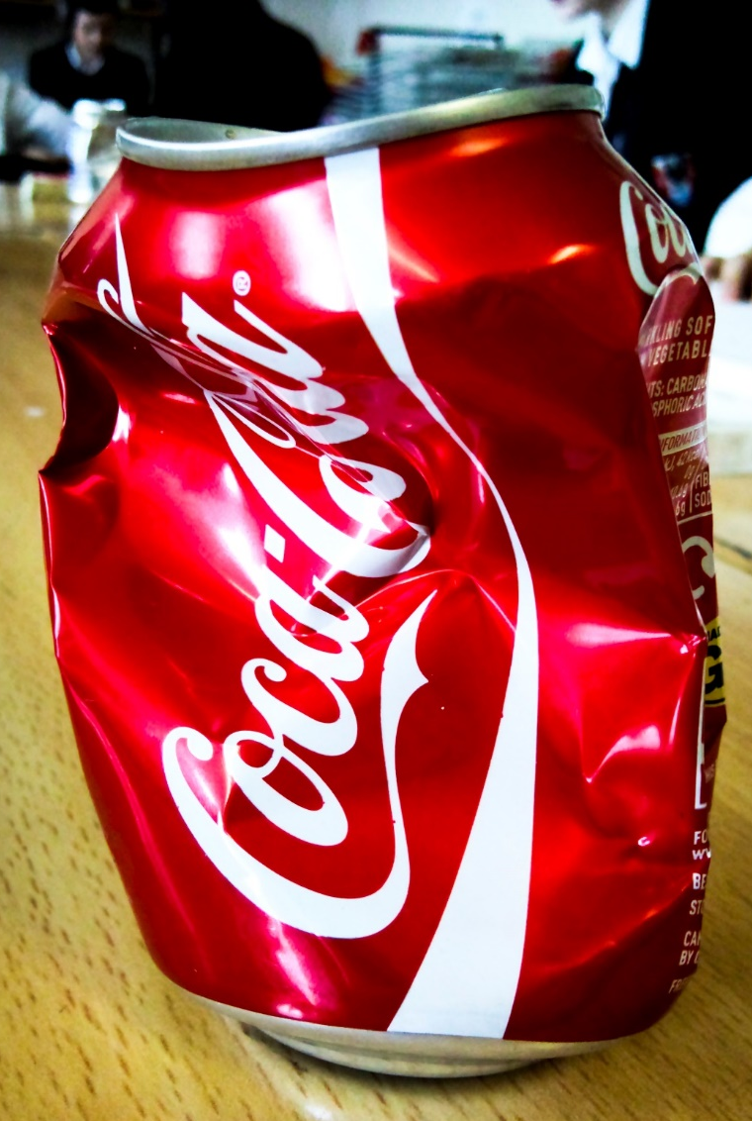

Art and Design Family Learning Pack
Coke Can Challenge
1. Watch Miss Duguid’s demonstration
2. From the photos in the pack sketch out the coke can in pencil
3. Use a fine liner and water to create tone.
4. Challenge someone in your family to do this activity too.
5. Bring in to school – your art teacher will decide which one is most successful! Winners will be put on Twitter and Instagram!
Watch Miss Duguid demonstrate a pen and wash technique

